Slide 1
Web-Browser Architecture

Slide 2
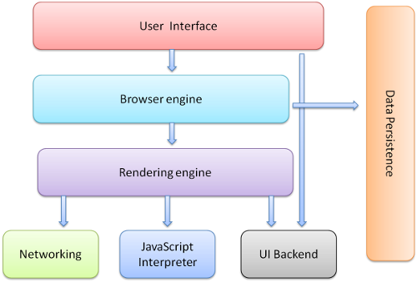
The browser's main components

Slide 3
The browser's main components
The User Interface: provides the methods with which a user inter-acts with the Browser Engine. This includes the address bar, back/forward button, bookmarking menu, etc. Every part of the browser display except the window where you see the requested page.

Slide 4
The browser's main components
The Browser Engine: marshals actions between the UI and the rendering engine. This provides a high-level interface to the Rendering Engine. The Browser Engine provides methods to initiate the loading of a URL and other high-level browsing actions (reload, back, forward). The Browser Engine also provides the User interface with various messages relating to error messages and loading progress.

Slide 5
The browser's main components
The Rendering Engine: produces the visual representation of a given URL. The Rendering Engine interprets the HTML, XML, and JavaScript that comprises a given URL and generates the layout that is displayed in the User Interface. A key component of the Rendering Engine is the HTML parser, this HTML parser is quite complex because it allows the Rendering Engine to display poorly formed HTML pages

Slide 6
The browser's main components
The Rendering Engine: Different browsers use different rendering engines: Internet Explorer uses Trident, Firefox uses Gecko, Safari uses WebKit. Chrome and Opera uses WebKit (before is Blink).

Slide 7
The browser's main components
The Networking: provides functionality to handle retrieve URLs using the common Internet protocols of HTTP and FTP. The Networking components handles all aspects of Internet communication and security, character set translations and MIME type resolution. The Network component may implement a cache of retrieved documents to minimize network traffic.

Slide 8
The browser's main components
The JavaScript Interpreter: component executes the JavaScript code that is embedded in a website. Results of the execution a passed to the Rendering Engine for display. The Rendering Engine may disable various actions based on user defined properties.

Slide 9
The browser's main components
The UI Backend:
Used for drawing basic widgets like combo boxes and windows
Underneath it uses operating system user interface methods.

Slide 10
The browser's main components
The Data Storage: manages user data such as bookmarks, cookies and preferences. The new HTML specification (HTML5) defines 'web database' which is a complete (although light) database in the browser.

Slide 11
The browser's main components
It is important to note that browsers such as Chrome run multiple instances of the rendering engine: one for each tab. Each tab runs in a separate process.

Slide 12
Rendering Engine – Basic flow
Step 1: Parsing the HTML document and convert elements to DOM nodes in a tree called the “content tree” – HTML Parser
Step 2: Parse the style data, both in external CSS files and in style element together with visual instructions in HTML will be used to create another tree, call “render tree” – CSS Parser

Slide 13
Rendering Engine – Basic flow
Step 3: After the construction of the render tree it goes through a “layout" process. This means giving each node the exact coordinates where it should appear on the screen
Step 4: The next stage is painting–the render tree will be traversed and each node will be painted using the UI backend layer - Painting.

Slide 14
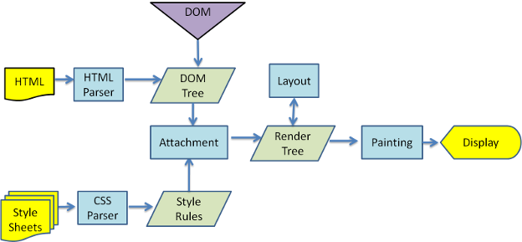
Rendering Engine
WebKit main flow

Slide 15
Rendering Engine Keys
HTML Parser: The job of the HTML parser is to parse the HTML markup into a parse tree.
DOM: The output tree (the "parse tree") is a tree of DOM element and attribute nodes.
CSS Parsing: CSS is a context free grammar and can be parsed using the types of parsers described in the introduction. In fact the CSS specification defines CSS lexical and syntax grammar.

Slide 16
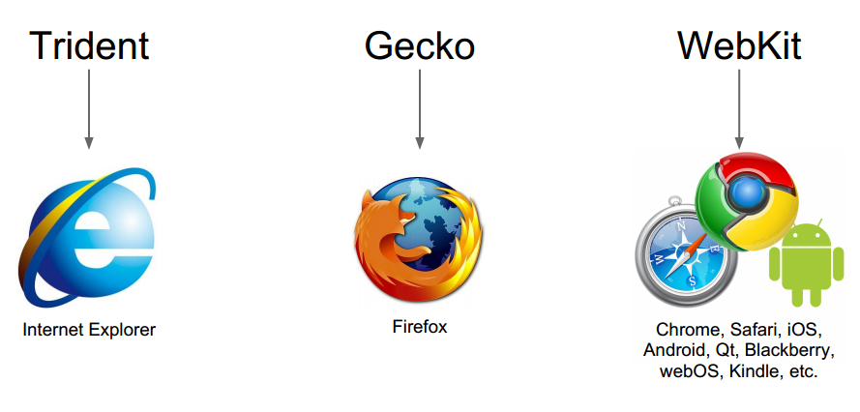
Primary Rendering Engine

Slide 17
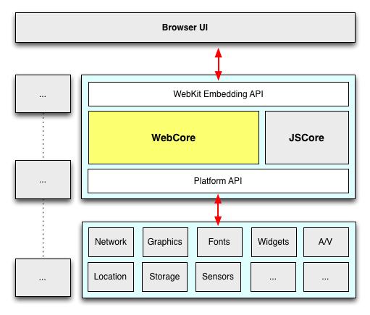
WebKit Rendering Engine
Is an open source project to layout web pages, taken from Apple.

Slide 18
WebKit Rendering Engine
WebKit embedding API: interface between rendering engine and Browser UI
WebCore: is application logic: loading, parsing, layout, style resolution, painting, event handling, editing, javascript bindings
JSCore (JavaScript Engine): V8 or JavaScriptCore, parses and executes page logic allows DOM manipulation
Platform API: Network stack, Graphics library, Font engine, Native widgets …

